Slide 1
CSE 417T Introduction to Machine Learning
Lecture 3 Instructor: Chien-Ju (CJ) Ho

Slide 2
Logistics
Enrollment and waitlist
Course website and Piazza
Website: http://chienjuho.com/courses/cse417t/
Piazza: http://piazza.com/wustl/spring2022/cse417t
Make sure you follow both regularly
Office hours
Will be announced later this week
Will start next week

Slide 3
Logistics
Homework 1
Will be announced later this week
A mixture of math questions and programming questions
Programming language: Python
We won’t teach you how to program python
Exam and Grades
Two in-lecture exams (one in the middle of semester, one in the last lecture)
What to expect for the final grades

Slide 4
Recap

Slide 5
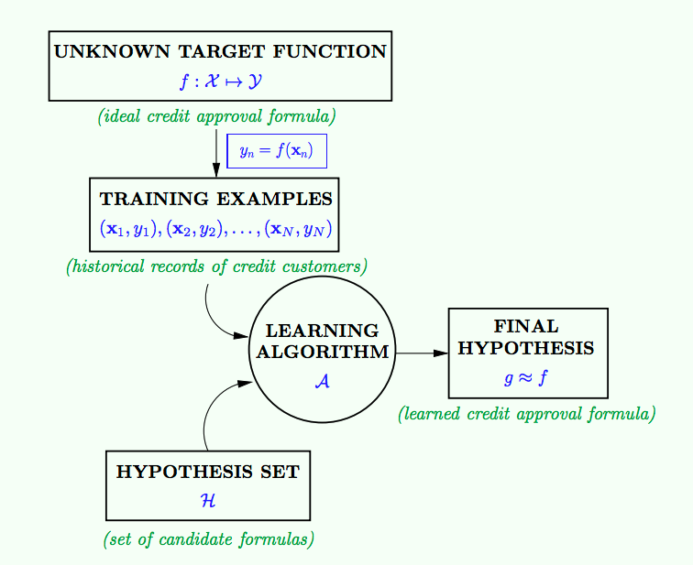
Given by the learning problem
learning model
(example: H: Perceptron
A: PLA)
Goal of learning

Slide 6
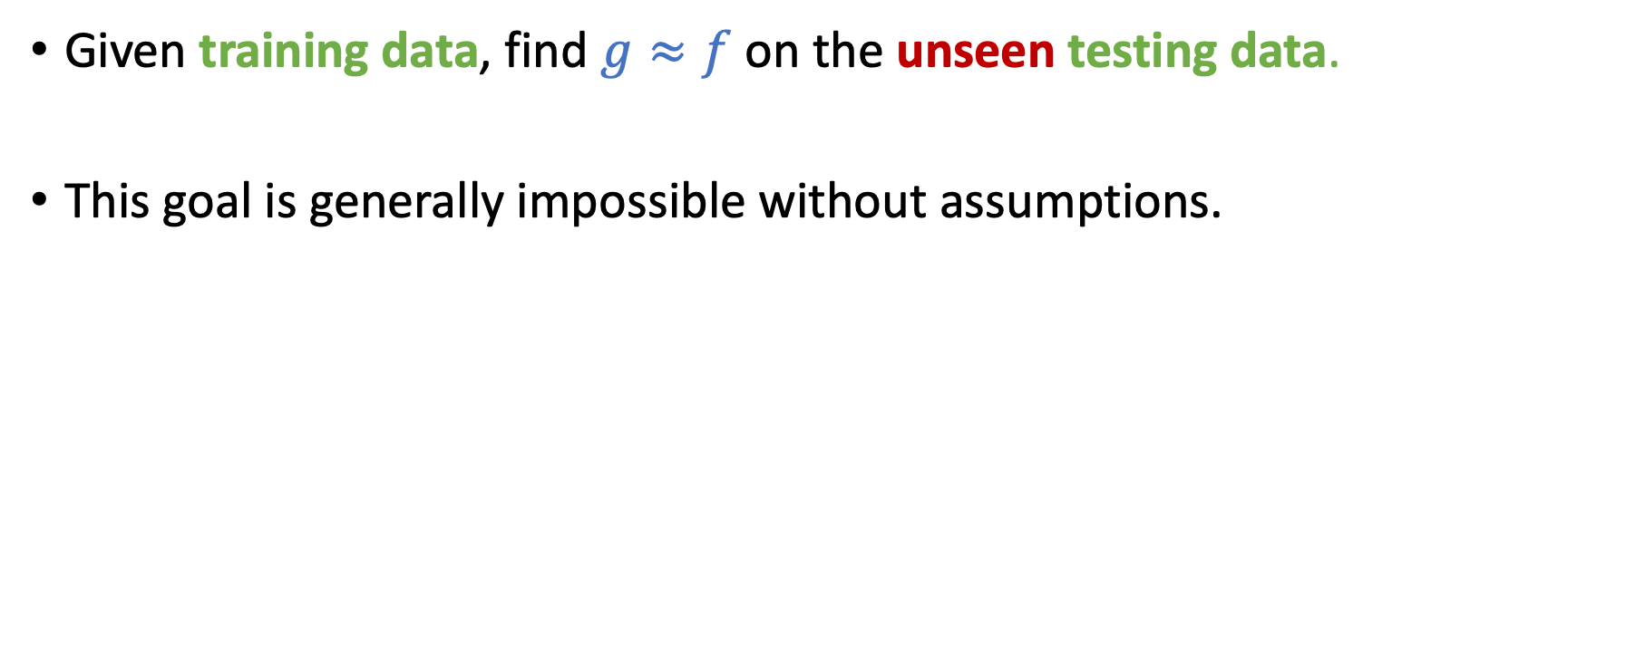
Goal of Learning: Generalization
Given training data, find $g≈f$ on the unseen testing data.
This goal is generally impossible without assumptions.
Key assumption of ML
Training data points and testing data points are i.i.d. drawn from the same (unknown) distribution

Slide 8
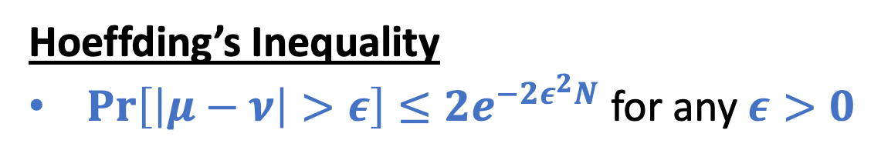
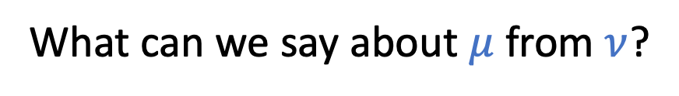
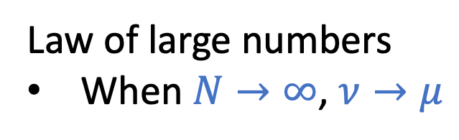
A Thought Experiment about Probability
What can we say about $μ$ from $ν$?
Draw with replacement
Law of large numbers
When $N→∞$, $ν→μ$
Hoeffding’s Inequality
$\operatorname{Pr}\left[\left|μ−ν\right|>ε\right]≤2e^{−2ε^{2}N}$ for any $ε>0$
N: number of samples

Slide 9
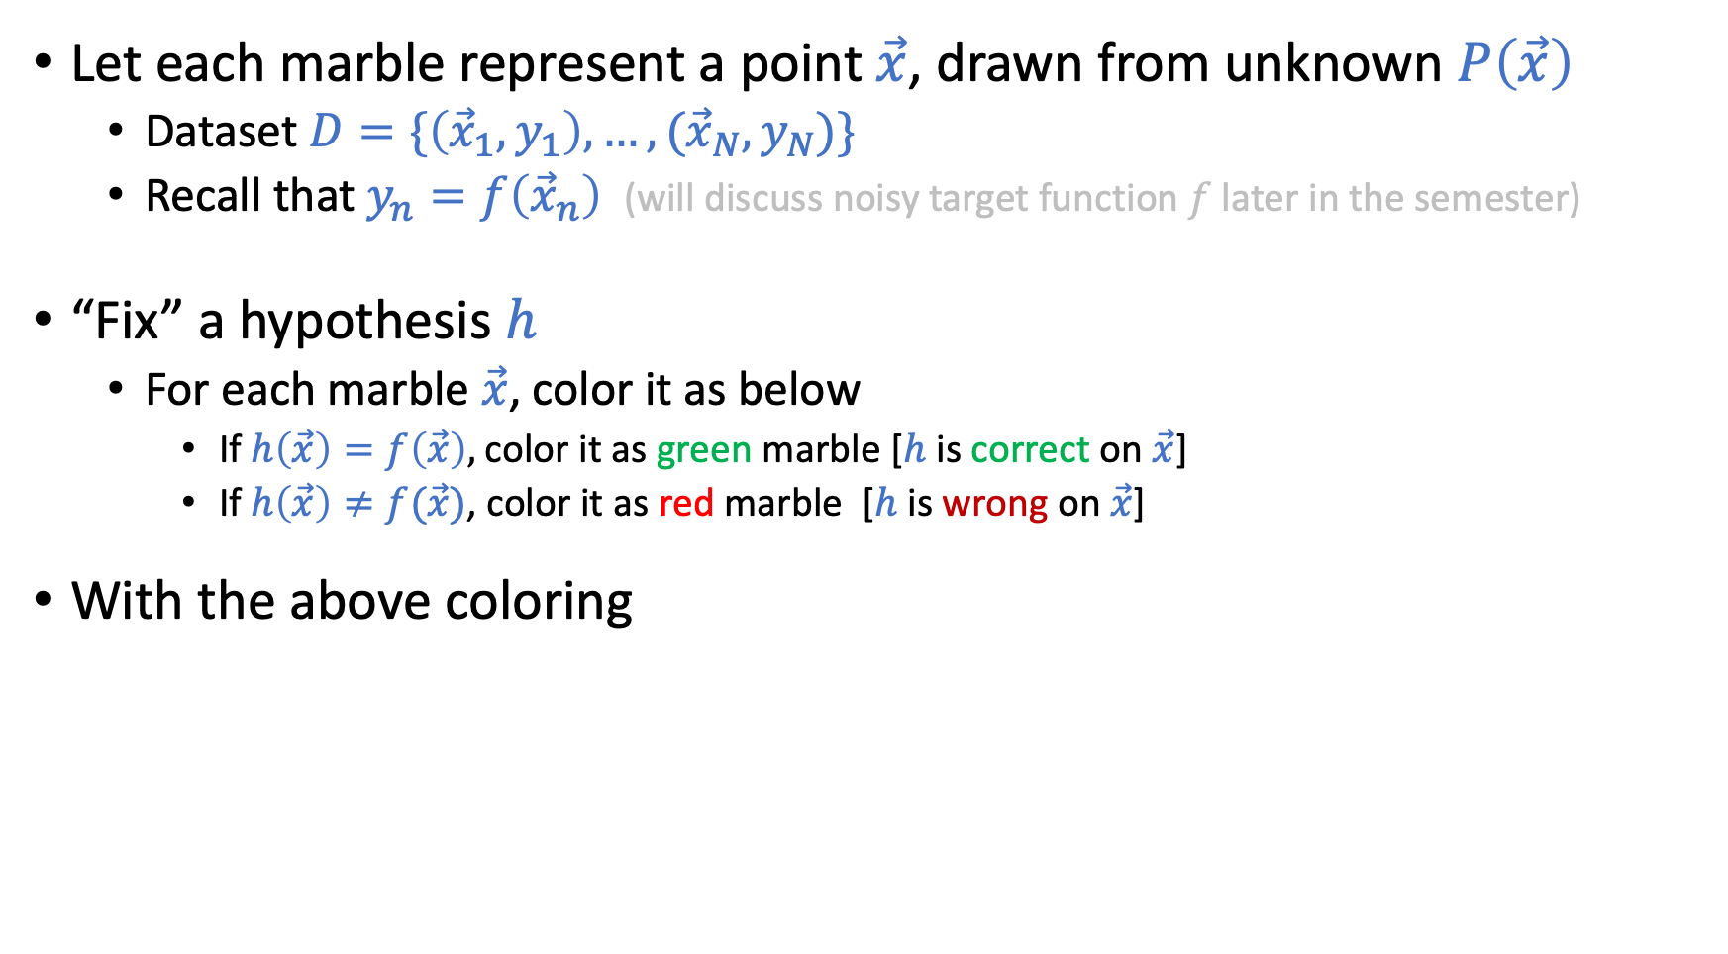
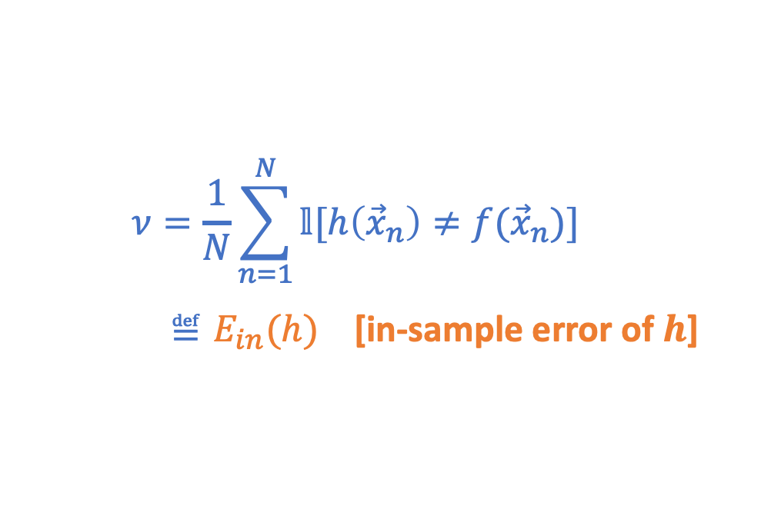
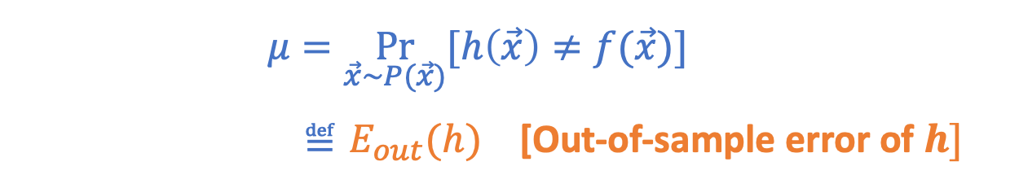
Connection to Learning
Let each marble represent a point $\vec{x}$, drawn from unknown $P\left(\vec{x}\right)$
Dataset $D=\{\left({\vec{x}}_{1},y_{1}\right),…,({\vec{x}}_{N},y_{N})\}$
Recall that $y_{n}=f\left({\vec{x}}_{n}\right)$ (will discuss noisy target function $f$ later in the semester)
“Fix” a hypothesis $h$
For each marble $\vec{x}$, color it as below
If $h\left(\vec{x}\right)=f\left(\vec{x}\right),$color it as green marble [$h$ is correct on $\vec{x}$]
If $h\left(\vec{x}\right)≠f(\vec{x})$, color it as red marble [$h$ is wrong on $\vec{x}$]
With the above coloring
Draw with replacement
N: number of samples
$$ν=\frac{1}{N}\sum_{n=1}^{N}{𝕝[h\left({\vec{x}}_{n}\right)≠f({\vec{x}}_{n})]}$$
$≝E_{in}(h)$ [in-sample error of $h\text{]}$
$$μ=\underset{\vec{x}\sim P(\vec{x})}{Pr}{[h\left(\vec{x}\right)≠f(\vec{x})]}$$ $≝E_{out}(h)$ [Out-of-sample error of $h]$

Slide 10
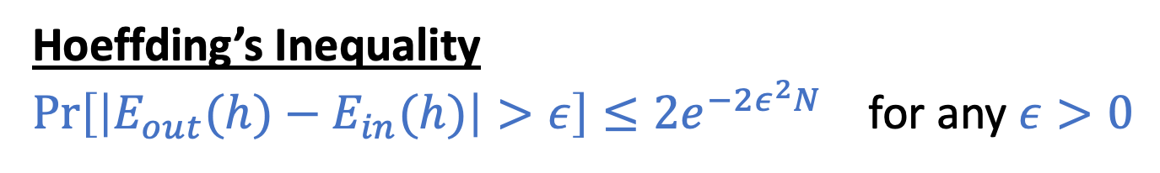
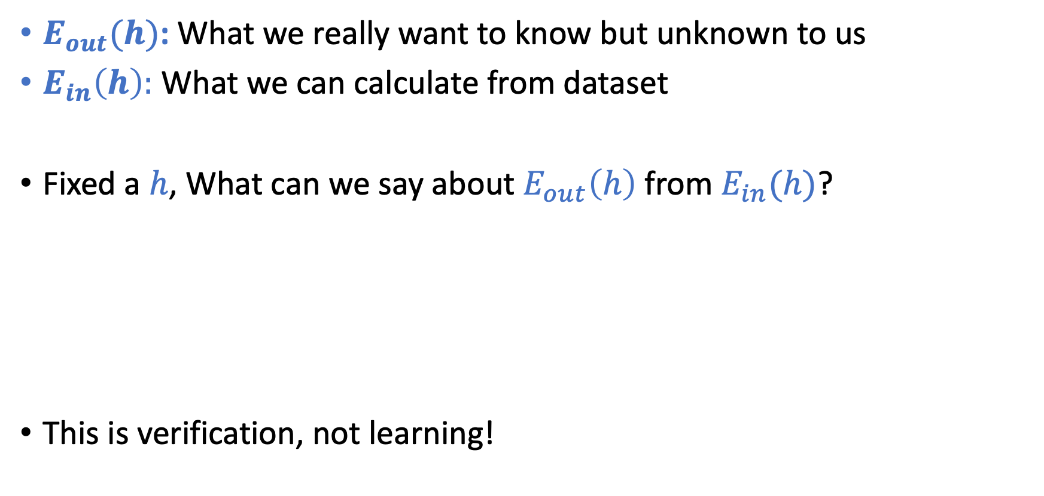
Connection to Learning
$E_{out}(h)$: What we really want to know but unknown to us
$E_{in}\left(h\right):$ What we can calculate from dataset
Fixed a $h$, What can we say about $E_{out}\left(h\right)$ from $E_{in}(h)$?
This is verification, not learning!
Hoeffding’s Inequality
$\operatorname{Pr}\left[\left|E_{out}(h)−E_{in}(h)\right|>ε\right]≤2e^{−2ε^{2}N}$ for any $ε>0$

Slide 11
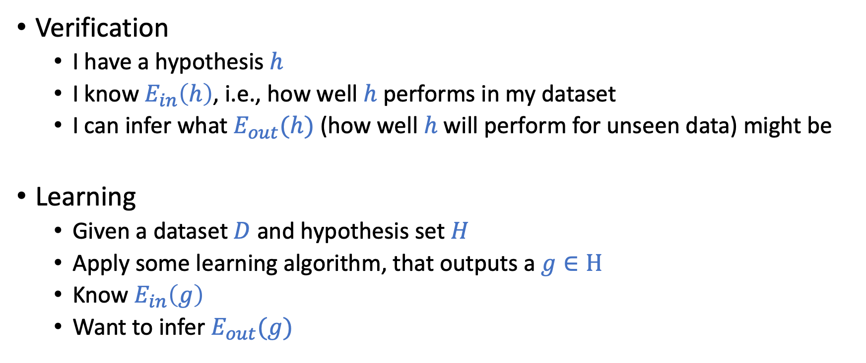
Verification vs. Learning
Verification
I have a hypothesis $h$
I know $E_{in}\left(h\right)$, i.e., how well $h$ performs in my dataset
I can infer what $E_{out}(h)$ (how well $h$ will perform for unseen data) might be
Learning
Given a dataset $D$and hypothesis set $H$
Apply some learning algorithm, that outputs a $g∈H$
Know $E_{in}\left(g\right)$
Want to infer $E_{out}(g)$

Slide 12
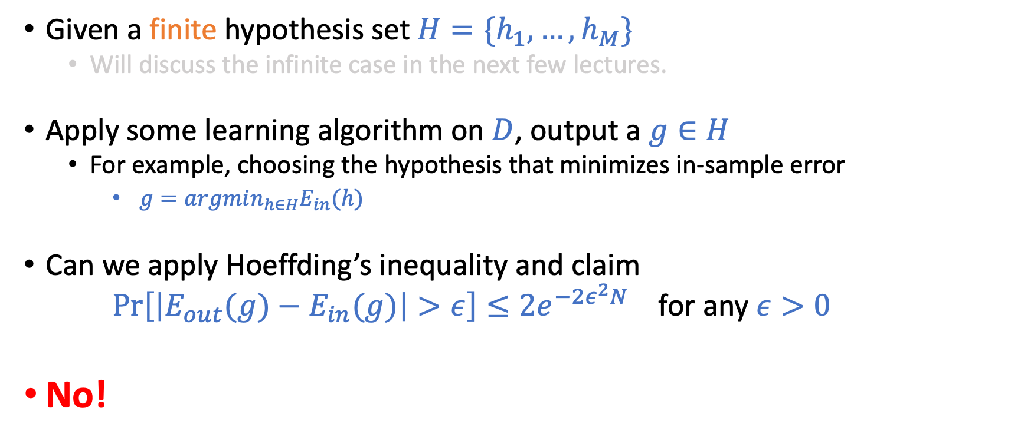
Connection to “Real” Learning
Given a finite hypothesis set $H=\{h_{1},…,h_{M}\}$
Will discuss the infinite case in the next few lectures.
Apply some learning algorithm on $D$, output a $g∈H$
For example, choosing the hypothesis that minimizes in-sample error
$g=argmin_{h∈H}E_{in}(h)$
Can we apply Hoeffding’s inequality and claim $\operatorname{Pr}\left[\left|E_{out}(g)−E_{in}(g)\right|>ε\right]≤2e^{−2ε^{2}N}$ for any $ε>0$
No!

Slide 13
Today’s Lecture
The notes are not intended to be comprehensive.
Let me know if you spot errors.

Slide 14
An Analogy
Three fair coins, numbered by 1, 2, 3. Flip each 10 times.
Question: (choosing from >5, =5, or <5)
For coin 1, what’s the expected number of heads among 10 flips?
Randomly choose a coin, what’s the expected number of heads for this coin?
Look at the realized flips and choose the coin with the largest number of heads. What is the expected number of heads for the coin?
Without observing the flips, choose the coin anyway you like, what is the expected number of heads of the 10 flips for this coin?
You will simulate this process (with 1,000 coins) in HW1.
Ans: = 5
Ans: = 5
Ans: >5
Ans: = 5

Slide 15
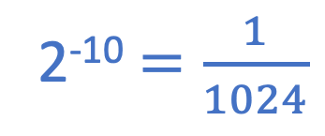
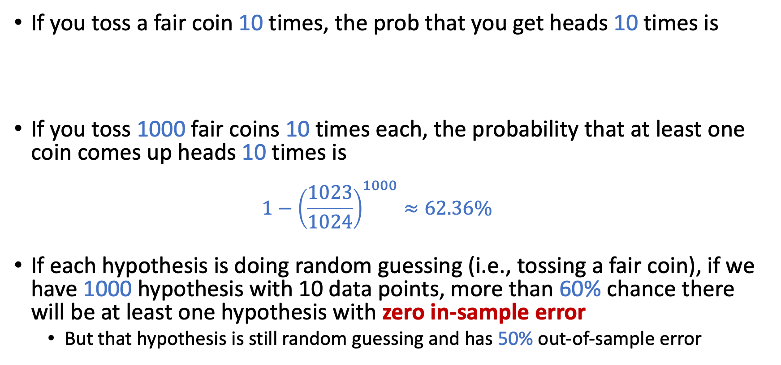
An Analogy
If you toss a fair coin 10 times, the prob that you get heads 10 times is
If you toss 1000 fair coins 10 times each, the probability that at least one coin comes up heads 10 times is
$$1−{\left(\frac{1023}{1024}\right)}^{1000}≈62.36\%$$
If each hypothesis is doing random guessing (i.e., tossing a fair coin), if we have 1000 hypothesis with 10 data points, more than 60% chance there will be at least one hypothesis with zero in-sample error
But that hypothesis is still random guessing and has 50% out-of-sample error
2⁻¹⁰ $=\frac{1}{1024}$

Slide 16
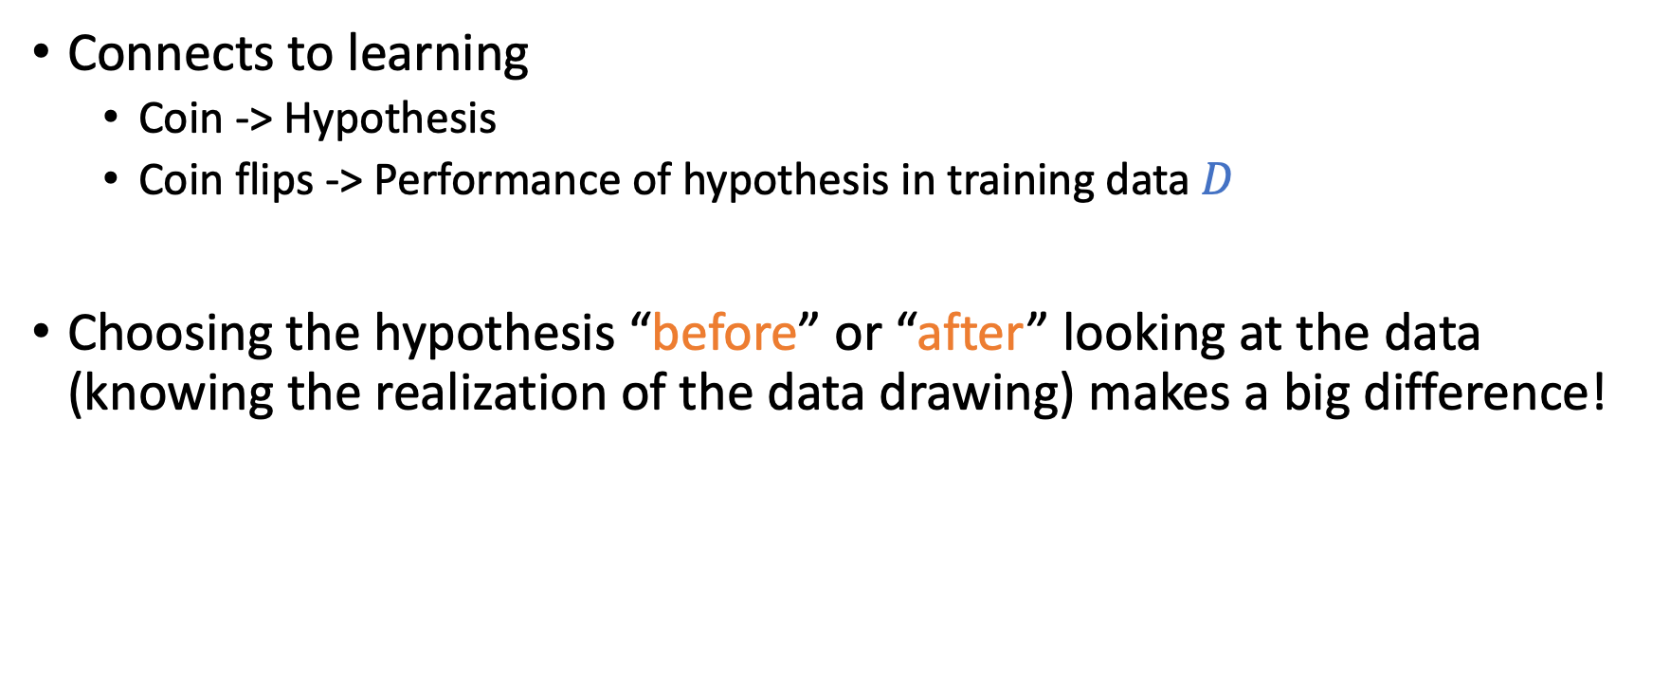
An Analogy
Connects to learning
Coin -> Hypothesis
Coin flips -> Performance of hypothesis in training data $D$
Choosing the hypothesis “before” or “after” looking at the data (knowing the realization of the data drawing) makes a big difference!

Slide 17

An Analogy
Hoeffding’s Inequality
$\operatorname{Pr}\left[\left|μ−ν\right|>ε\right]≤2e^{−2ε^{2}N}$ for any $ε>0$
Some graphical explanations
Notes:
Draw the PDF
Show that with more samples, the PDF “concentrates around mean”
Then argue that, if we sample multiple points from the same PDF, we are likely to get lucky

Slide 18
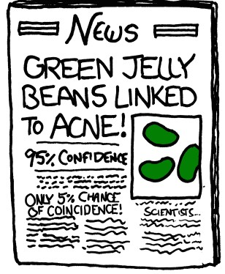

Slide 19
What Can We Do?

Slide 20
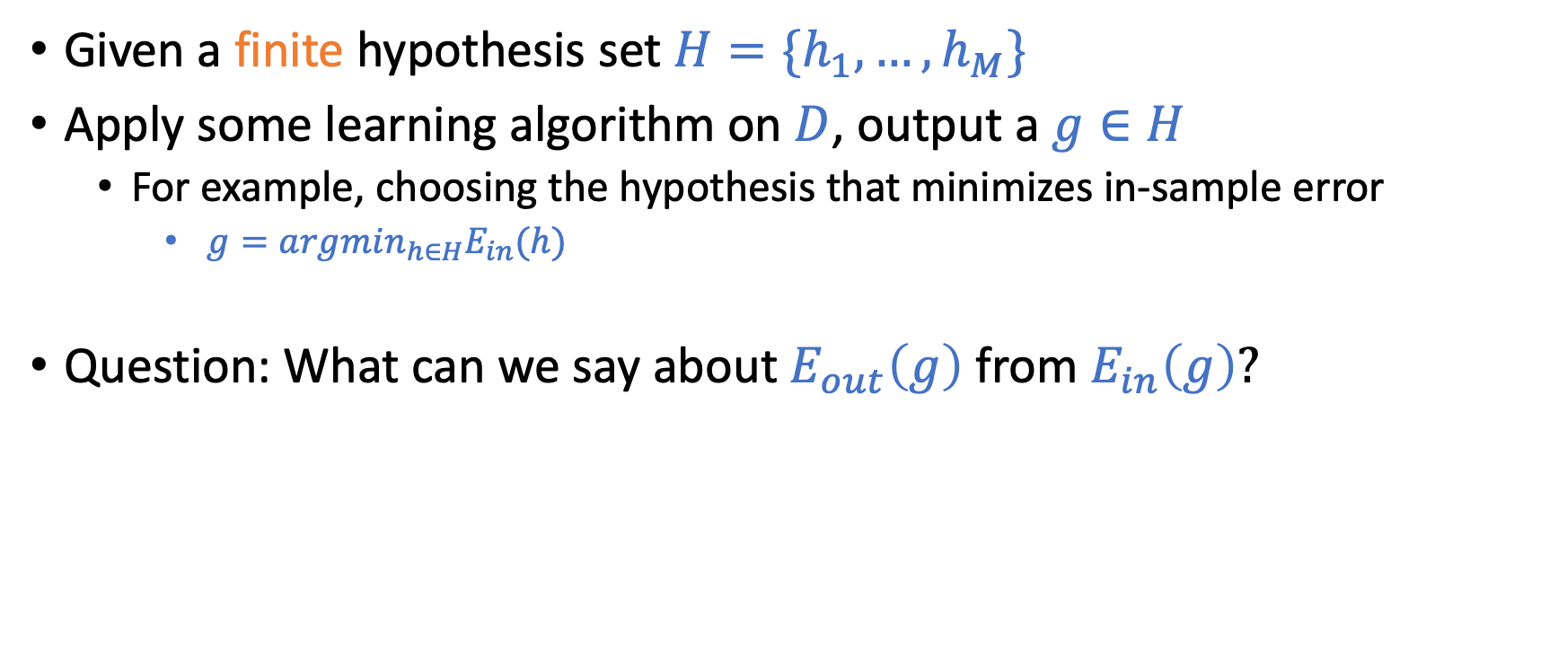
Connection to “Real” Learning
Given a finite hypothesis set $H=\{h_{1},…,h_{M}\}$
Apply some learning algorithm on $D$, output a $g∈H$
For example, choosing the hypothesis that minimizes in-sample error
$g=argmin_{h∈H}E_{in}(h)$
Question: What can we say about $E_{out}\left(g\right)$ from $E_{in}\left(g\right)?$

Slide 21
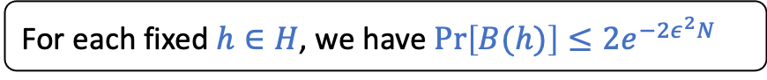
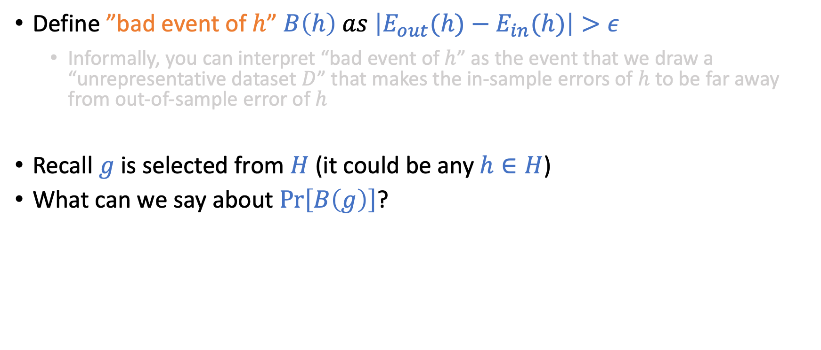
Derivations
Define ”bad event of $h$” $B\left(h\right) as \left|E_{out}(h)−E_{in}(h)\right|>ε$
Informally, you can interpret “bad event of $h$” as the event that we draw a “unrepresentative dataset $D$” that makes the in-sample errors of $h$ to be far away from out-of-sample error of $h$
Recall $g$ is selected from $H$ (it could be any $h∈H$)
What can we say about $\operatorname{Pr}\left[B\left(g\right)\right]$?
$$\operatorname{Pr}\left[B\left(g\right)\right]≤\operatorname{Pr}\left[B\left(h_{1}\right) or B\left(h_{2}\right) or …or B\left(h_{M}\right)\right]$$
$≤\operatorname{Pr}\left[B\left(h_{1}\right)\right]+$ $\operatorname{Pr}\left[B\left(h_{2}\right)\right]+…+Pr⁡[B(h_{M})]$
$≤M 2e^{−2ε^{2}N}$
For each fixed $h∈H$, we have $\operatorname{Pr}\left[B(h)\right]≤2e^{−2ε^{2}N}$

Slide 22
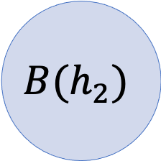
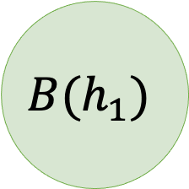
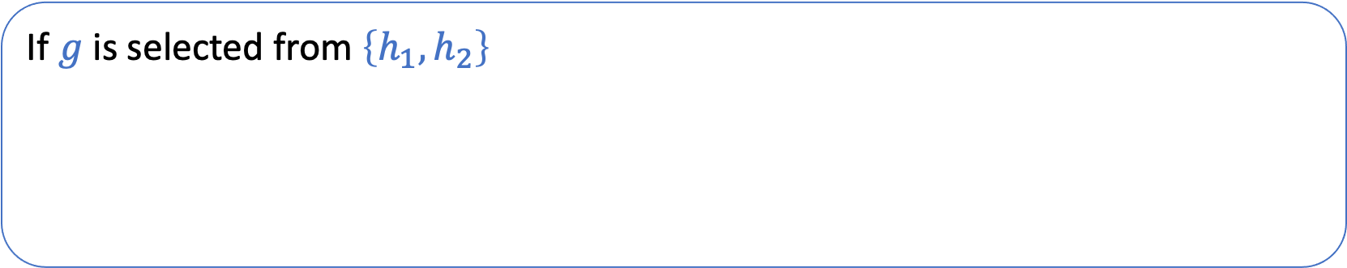
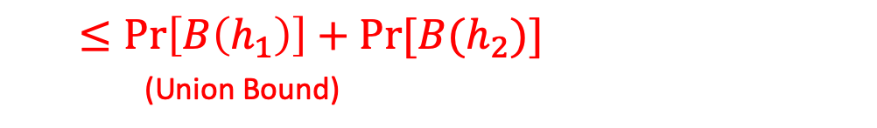
Derivations
Define ”bad event of $h$” $B\left(h\right) as \left|E_{out}(h)−E_{in}(h)\right|>ε$
Informally, you can interpret “bad event of $h$” as the event that we draw a “unrepresentative dataset $D$” that makes the in-sample errors of $h$ to be far away from out-of-sample error of $h$
Recall $g$ is selected from $H$ (it could be any $h∈H$)
What can we say about $\operatorname{Pr}\left[B\left(g\right)\right]$?
$$\operatorname{Pr}\left[B\left(g\right)\right]≤\operatorname{Pr}\left[B\left(h_{1}\right) or B\left(h_{2}\right) or …or B\left(h_{M}\right)\right]$$
$≤\operatorname{Pr}\left[B\left(h_{1}\right)\right]+$ $\operatorname{Pr}\left[B\left(h_{2}\right)\right]+…+Pr⁡[B(h_{M})]$
$≤M 2e^{−2ε^{2}N}$
For each fixed $h∈H$, we have $\operatorname{Pr}\left[B(h)\right]≤2e^{−2ε^{2}N}$
If $g$ is selected from $\left\{h_{1},h_{2}\right\}$
$$B\left(g\right)⊆B\left(h_{1}\right)∪B\left(h_{2}\right)$$
$$B(h_{1})$$
$$B(h_{2})$$
$$\operatorname{Pr}\left[B\left(g\right)\right]≤\operatorname{Pr}\left[B\left(h_{1}\right) \text{or} B\left(h_{2}\right)\right]$$
$≤\operatorname{Pr}\left[B\left(h_{1}\right)\right]+Pr⁡[B(h_{2})]$ (Union Bound)

Slide 23
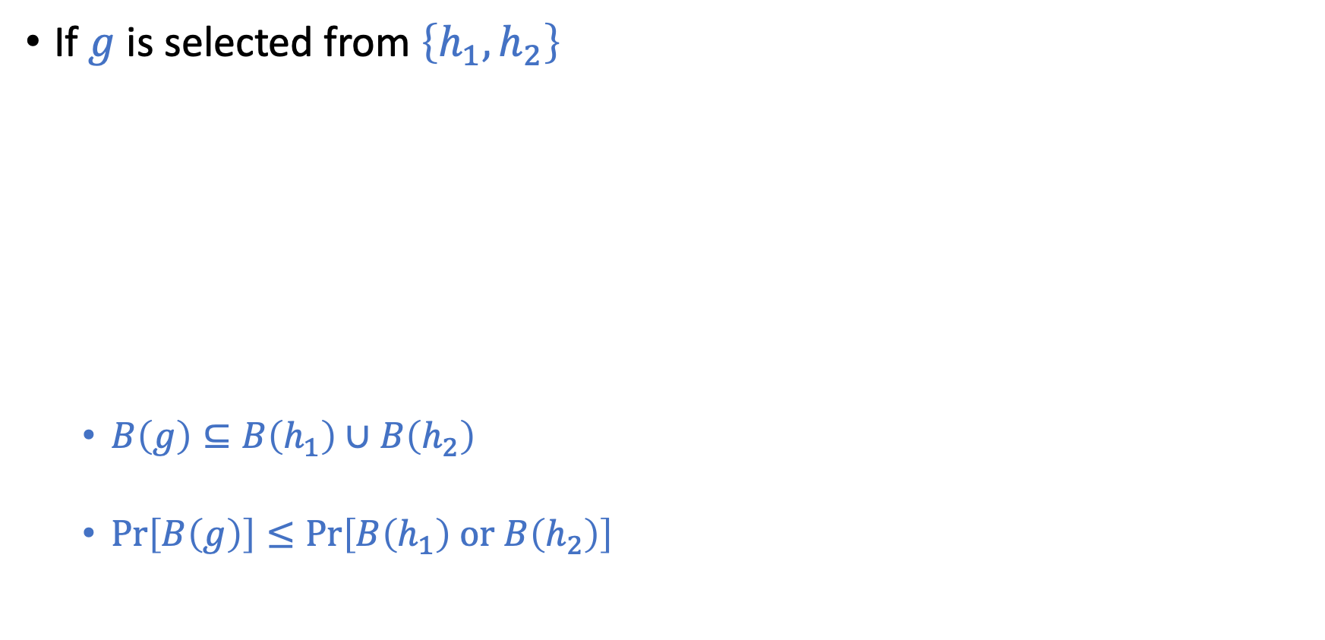

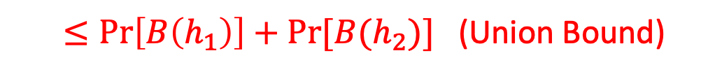
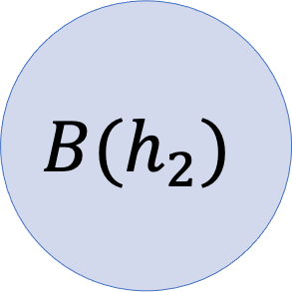
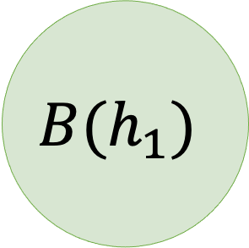
Bounding $\operatorname{Pr}\left[B\left(g\right)\right]$?
If $g$ is selected from $\left\{h_{1},h_{2}\right\}$
$B\left(g\right)⊆B\left(h_{1}\right)∪B\left(h_{2}\right)$
$\operatorname{Pr}\left[B\left(g\right)\right]≤\operatorname{Pr}\left[B\left(h_{1}\right) \text{or} B\left(h_{2}\right)\right]$
$$B(h_{1})$$
$$B(h_{2})$$
$≤\operatorname{Pr}\left[B\left(h_{1}\right)\right]+Pr⁡[B(h_{2})]$ (Union Bound)

Slide 24
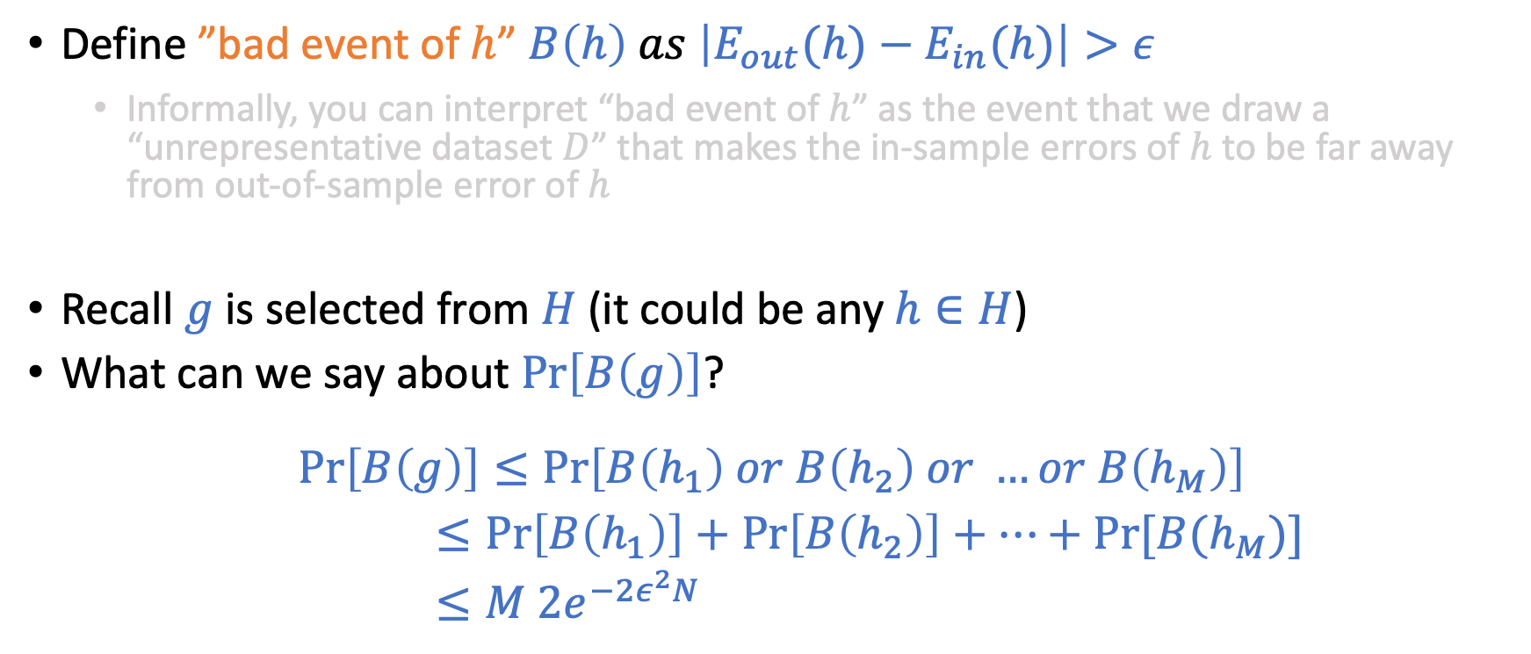
Derivations
Define ”bad event of $h$” $B\left(h\right) as \left|E_{out}(h)−E_{in}(h)\right|>ε$
Informally, you can interpret “bad event of $h$” as the event that we draw a “unrepresentative dataset $D$” that makes the in-sample errors of $h$ to be far away from out-of-sample error of $h$
Recall $g$ is selected from $H$ (it could be any $h∈H$)
What can we say about $\operatorname{Pr}\left[B\left(g\right)\right]$?
$$\operatorname{Pr}\left[B\left(g\right)\right]≤\operatorname{Pr}\left[B\left(h_{1}\right) or B\left(h_{2}\right) or …or B\left(h_{M}\right)\right]$$
$≤\operatorname{Pr}\left[B\left(h_{1}\right)\right]+$ $\operatorname{Pr}\left[B\left(h_{2}\right)\right]+…+Pr⁡[B(h_{M})]$
$≤M 2e^{−2ε^{2}N}$
For each fixed $h∈H$, we have $\operatorname{Pr}\left[B(h)\right]≤2e^{−2ε^{2}N}$

Slide 25
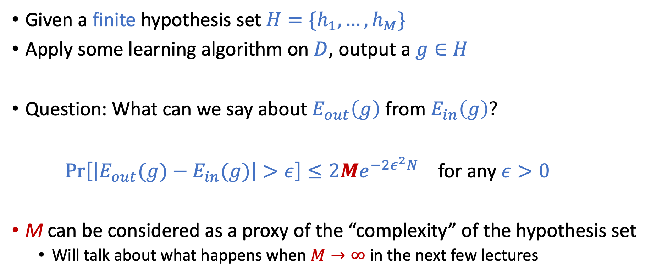
Connection to “Real” Learning
Given a finite hypothesis set $H=\{h_{1},…,h_{M}\}$
Apply some learning algorithm on $D$, output a $g∈H$
Question: What can we say about $E_{out}\left(g\right)$ from $E_{in}\left(g\right)?$
$\operatorname{Pr}\left[\left|E_{out}(g)−E_{in}(g)\right|>ε\right]≤2Me^{−2ε^{2}N}$ for any $ε>0$
M can be considered as a proxy of the “complexity” of the hypothesis set
Will talk about what happens when $M→∞$ in the next few lectures

Slide 26
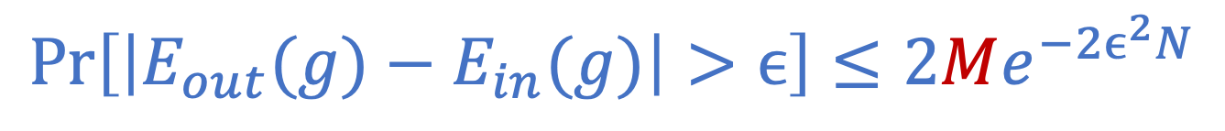
Interpreting
$$\operatorname{Pr}\left[\left|E_{out}(g)−E_{in}(g)\right|>ϵ\right]≤2Me^{−2ϵ^{2}N}$$

Slide 27
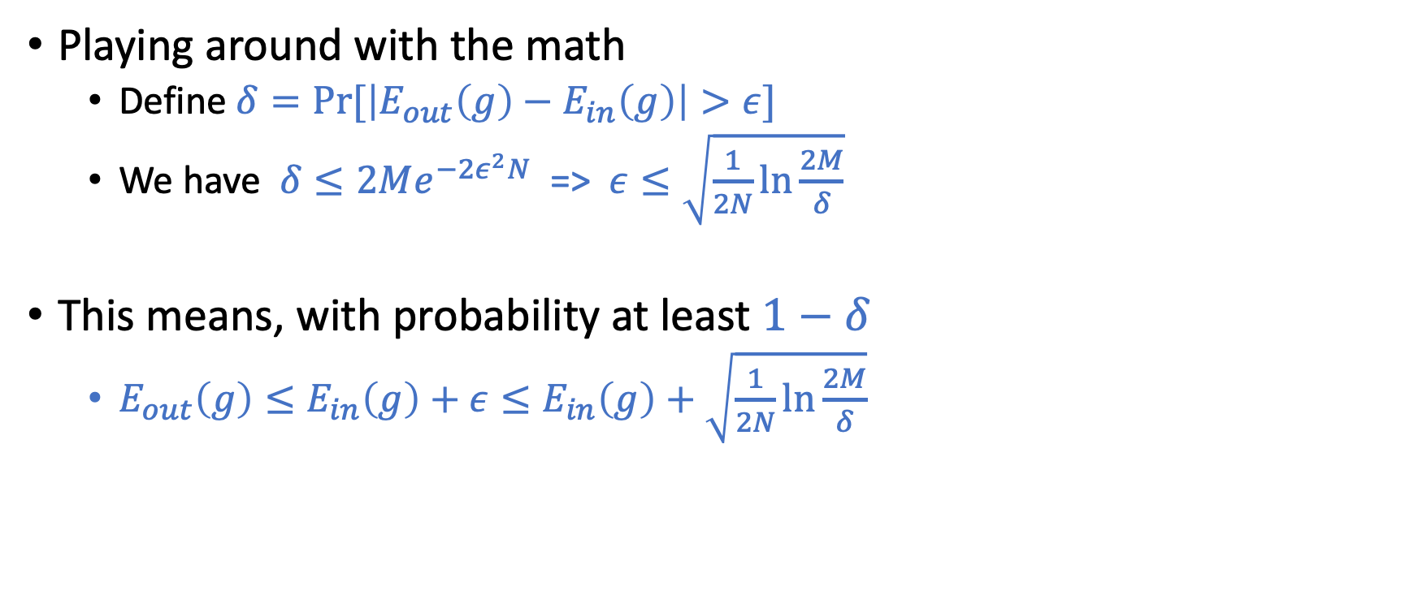
Interpreting
$$\operatorname{Pr}\left[\left|E_{out}(g)−E_{in}(g)\right|>ϵ\right]≤2Me^{−2ϵ^{2}N}$$
Playing around with the math
Define $δ=Pr⁡[\left|E_{out}\left(g\right)−E_{in}\left(g\right)\right|>ε]$
We have $δ≤2Me^{−2ε^{2}N}$ => $ε≤\sqrt{\frac{1}{2N}\ln{\frac{2M}{δ}}}$
This means, with probability at least $1−δ$
$E_{out}\left(g\right)≤E_{in}\left(g\right)+ε≤E_{in}\left(g\right)+$ $\sqrt{\frac{1}{2N}\ln{\frac{2M}{δ}}}$

Slide 28
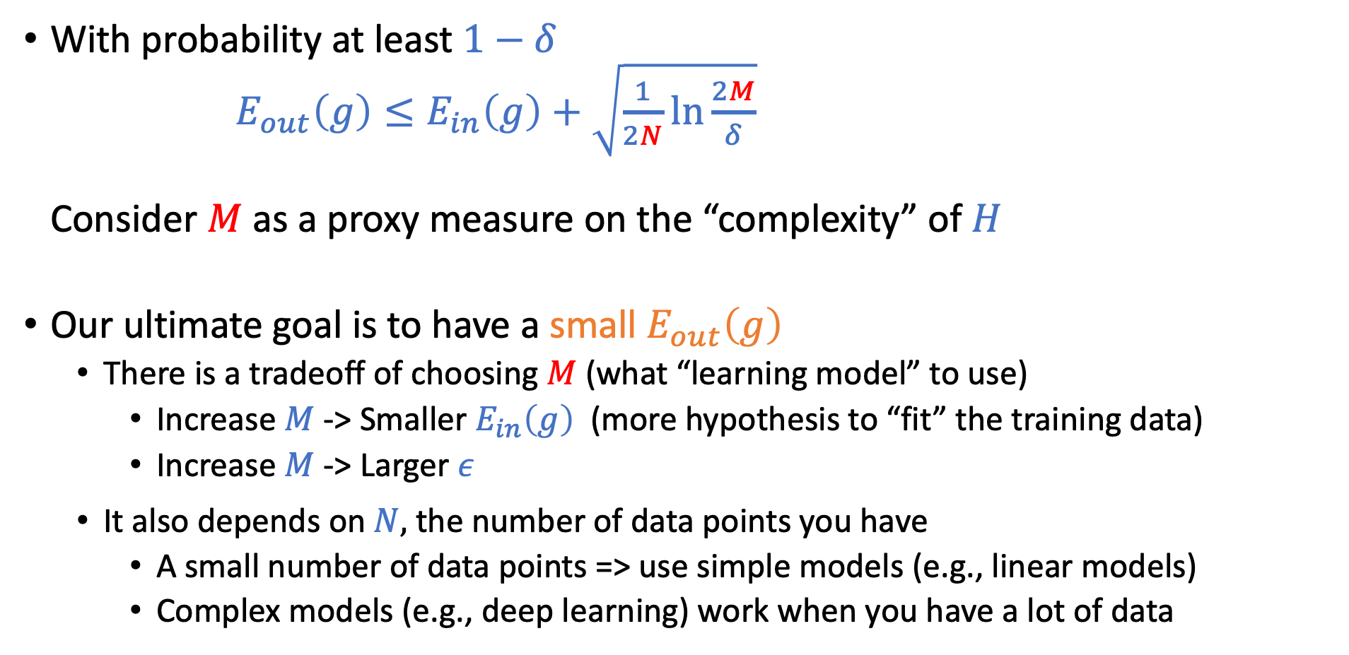
More Discussion
With probability at least $1−δ$ $E_{out}\left(g\right)≤E_{in}\left(g\right)+$ $\sqrt{\frac{1}{2N}\ln{\frac{2M}{δ}}}$ Consider $M$ as a proxy measure on the “complexity” of $H$
Our ultimate goal is to have a small $E_{out}\left(g\right)$
There is a tradeoff of choosing $M$ (what “learning model” to use)
Increase $M$ -> Smaller $E_{in}\left(g\right)$ (more hypothesis to “fit” the training data)
Increase $M$ -> Larger $ε$
It also depends on $N,$ the number of data points you have
A small number of data points => use simple models (e.g., linear models)
Complex models (e.g., deep learning) work when you have a lot of data

Slide 29
Revisit the Learning Problem

Slide 30

How to generally characterize $g≈f$

Slide 31
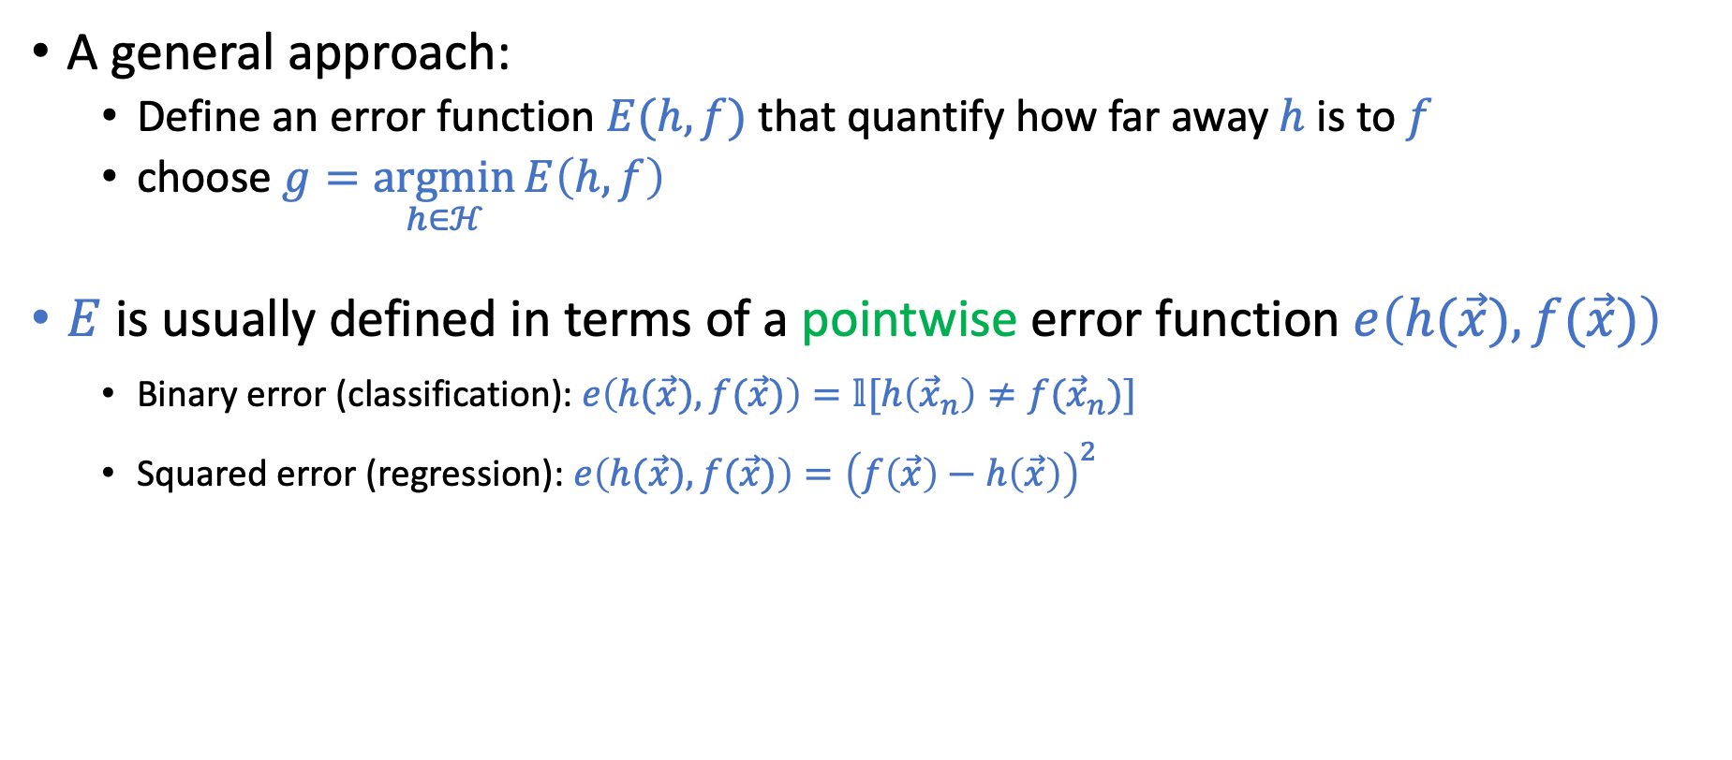


Goal: $g≈f$
A general approach:
Define an error function $E(h,f)$ that quantify how far away $h$ is to $f$
choose $g=\underset{h∈ℋ}{argmin}{E\left(h,f\right)}$
$E$ is usually defined in terms of a pointwise error function $e\left(h(\vec{x}),f(\vec{x})\right)$
Binary error (classification):$e\left(h(\vec{x}),f(\vec{x})\right)=𝕝[h\left({\vec{x}}_{n}\right)≠f({\vec{x}}_{n})]$
Squared error (regression): $e\left(h(\vec{x}),f(\vec{x})\right)={\left(f\left(\vec{x}\right)−h\left(\vec{x}\right)\right)}^{2}$
${ E}_{in}\left(h\right)=$ $\frac{1}{N}\sum_{n=1}^{N}{e(h\left({\vec{x}}_{n}\right),f\left({\vec{x}}_{n}\right))}$
$$E_{out}\left(h\right)=𝔼_{\vec{x}}[e(h\left(\vec{x}\right),f\left(\vec{x}\right))]$$
The discussion on the Hoeffding’s inequality applies for general (bounded) error functions.

Slide 32
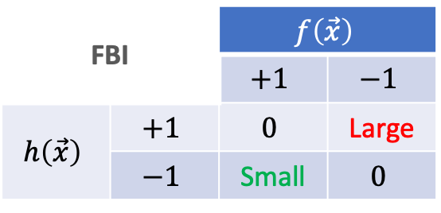
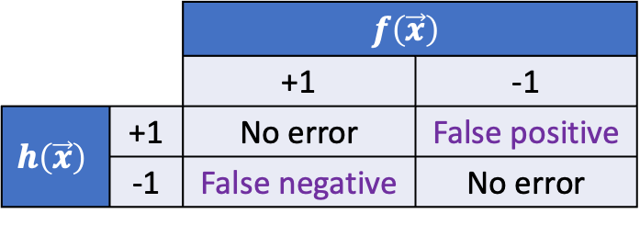
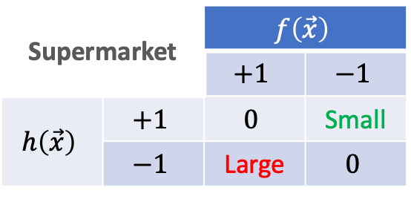
How to choose the error function?
Consideration 1: Properties of domain applications
Example: Fingerprint recognition
Input: fingerprints
Outputs: whether the person is authorized
Supermarket |  | $$f\left(\vec{x}\right)$$
 |  | $$+1$$ | $$−1$$
$$h\left(\vec{x}\right)$$ | $$+1$$ | $$0$$ | Small
 | $$−1$$ | Large | $$0$$
 |  | $$f\left(\vec{x}\right)$$
 |  | +1 | -1
$$h\left(\vec{x}\right)$$ | +1 | No error | False positive
 | -1 | False negative | No error
FBI |  | $$f\left(\vec{x}\right)$$
 |  | $$+1$$ | $$−1$$
$$h\left(\vec{x}\right)$$ | $$+1$$ | $$0$$ | Large
 | $$−1$$ | Small | $$0$$

Slide 33
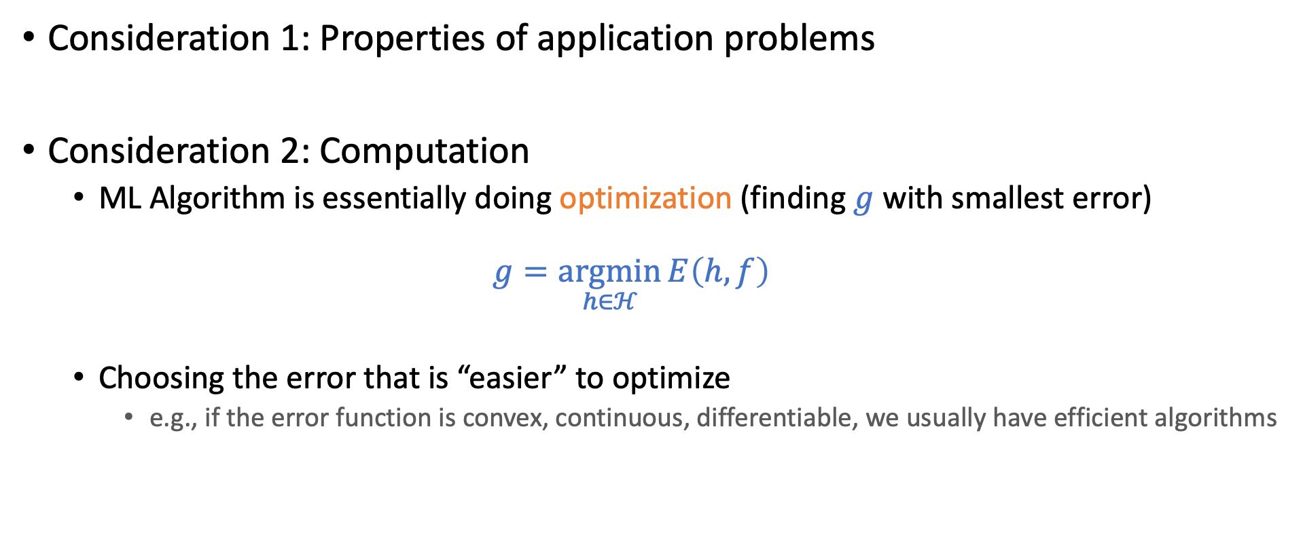
How to choose the error function?
Consideration 1: Properties of application problems
Consideration 2: Computation
ML Algorithm is essentially doing optimization (finding $g$ with smallest error)
$$g=\underset{h∈ℋ}{argmin}{E\left(h,f\right)}$$
Choosing the error that is “easier” to optimize
e.g., if the error function is convex, continuous, differentiable, we usually have efficient algorithms

Slide 34
How to choose the error function?
Consideration 1: Properties of application problems
Consideration 2: Computation
Specifying the error function is part of setting up the learning problem
It impacts what you eventually learn

Slide 36
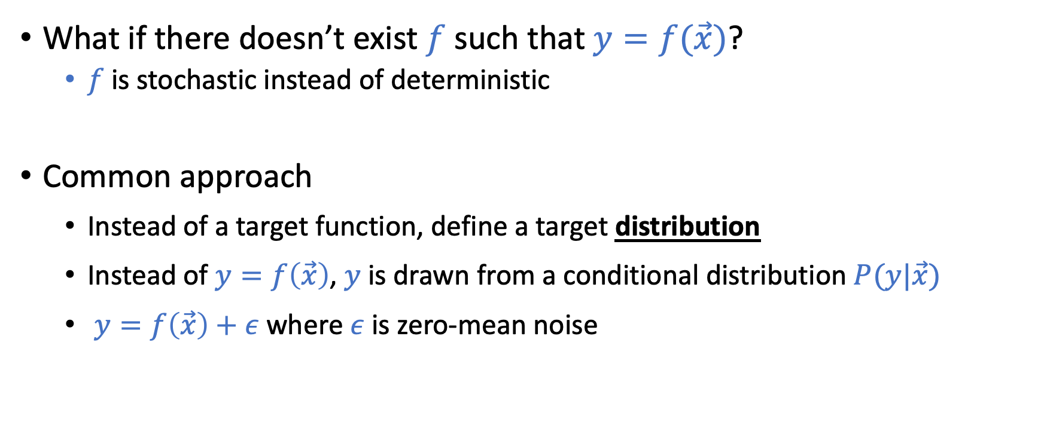
Noisy Target
What if there doesn’t exist $f$ such that $y=f(\vec{x})$?
$f$ is stochastic instead of deterministic
Common approach
Instead of a target function, define a target distribution
Instead of $y=f\left(\vec{x}\right)$, $y$ is drawn from a conditional distribution $P(y|\vec{x})$
$y=f\left(\vec{x}\right)+ε$ where $ε$ is zero-mean noise
The discussion on the Hoeffding’s inequality applies for noisy targets.

Slide 37
General Setup of (Supervised) Learning

Slide 38
Theory of Generalization

Slide 39
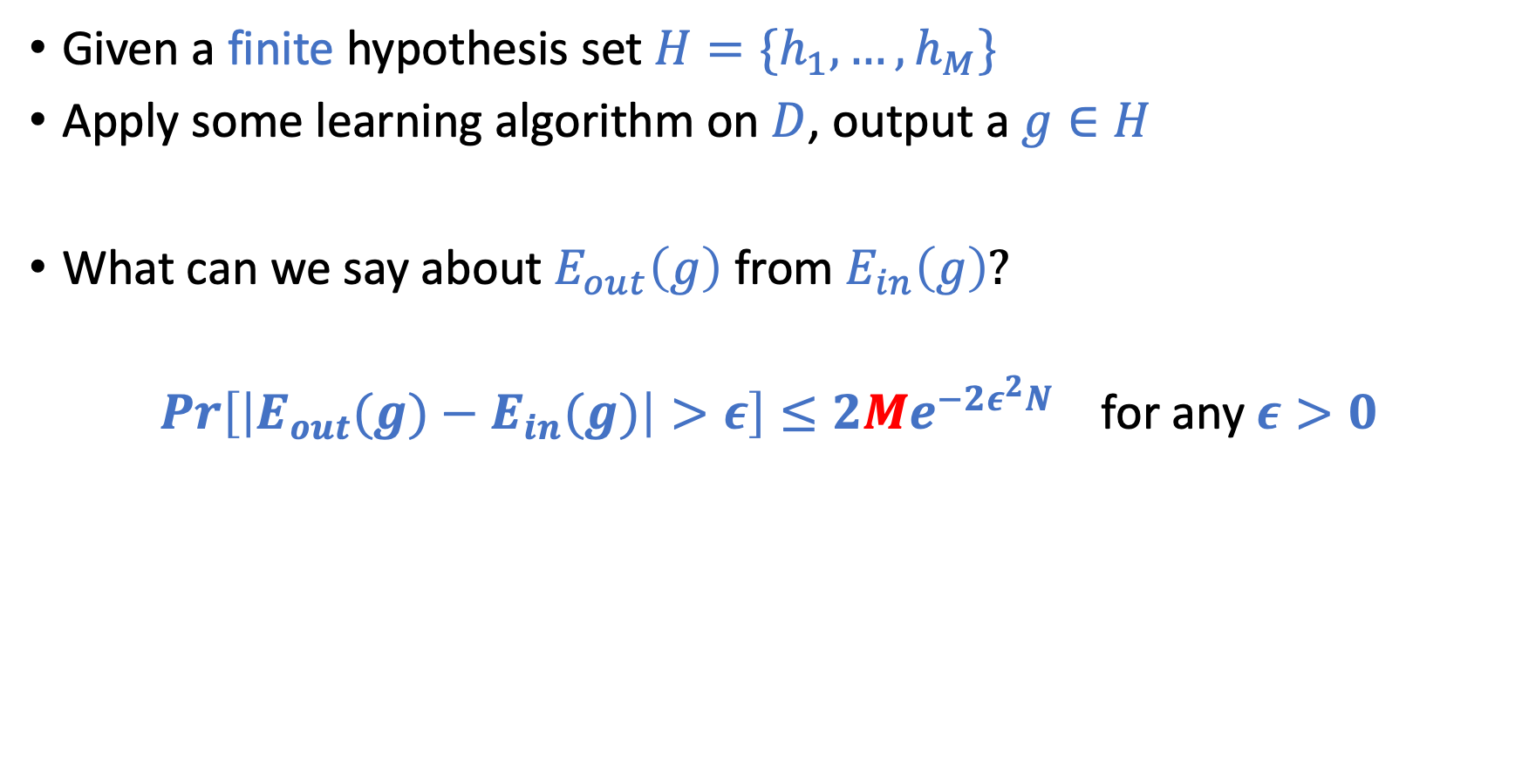
Revisit the “Multi-Hypothesis” Bound
Given a finite hypothesis set $H=\{h_{1},…,h_{M}\}$
Apply some learning algorithm on $D$, output a $g∈H$
What can we say about $E_{out}\left(g\right)$ from $E_{in}\left(g\right)?$
$\operatorname{Pr}\left[\left|E_{out}(g)−E_{in}(g)\right|>ε\right]≤2Me^{−2ε^{2}N}$ for any $ε>0$

Slide 40

What if $M$ is infinite?
$\operatorname{Pr}\left[\left|E_{out}(g)−E_{in}(g)\right|>ε\right]≤2Me^{−2ε^{2}N}$ don’t seem to carry any meanings

Slide 41
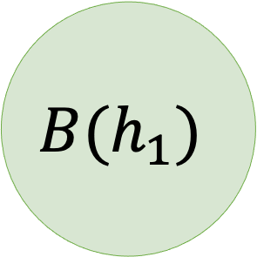
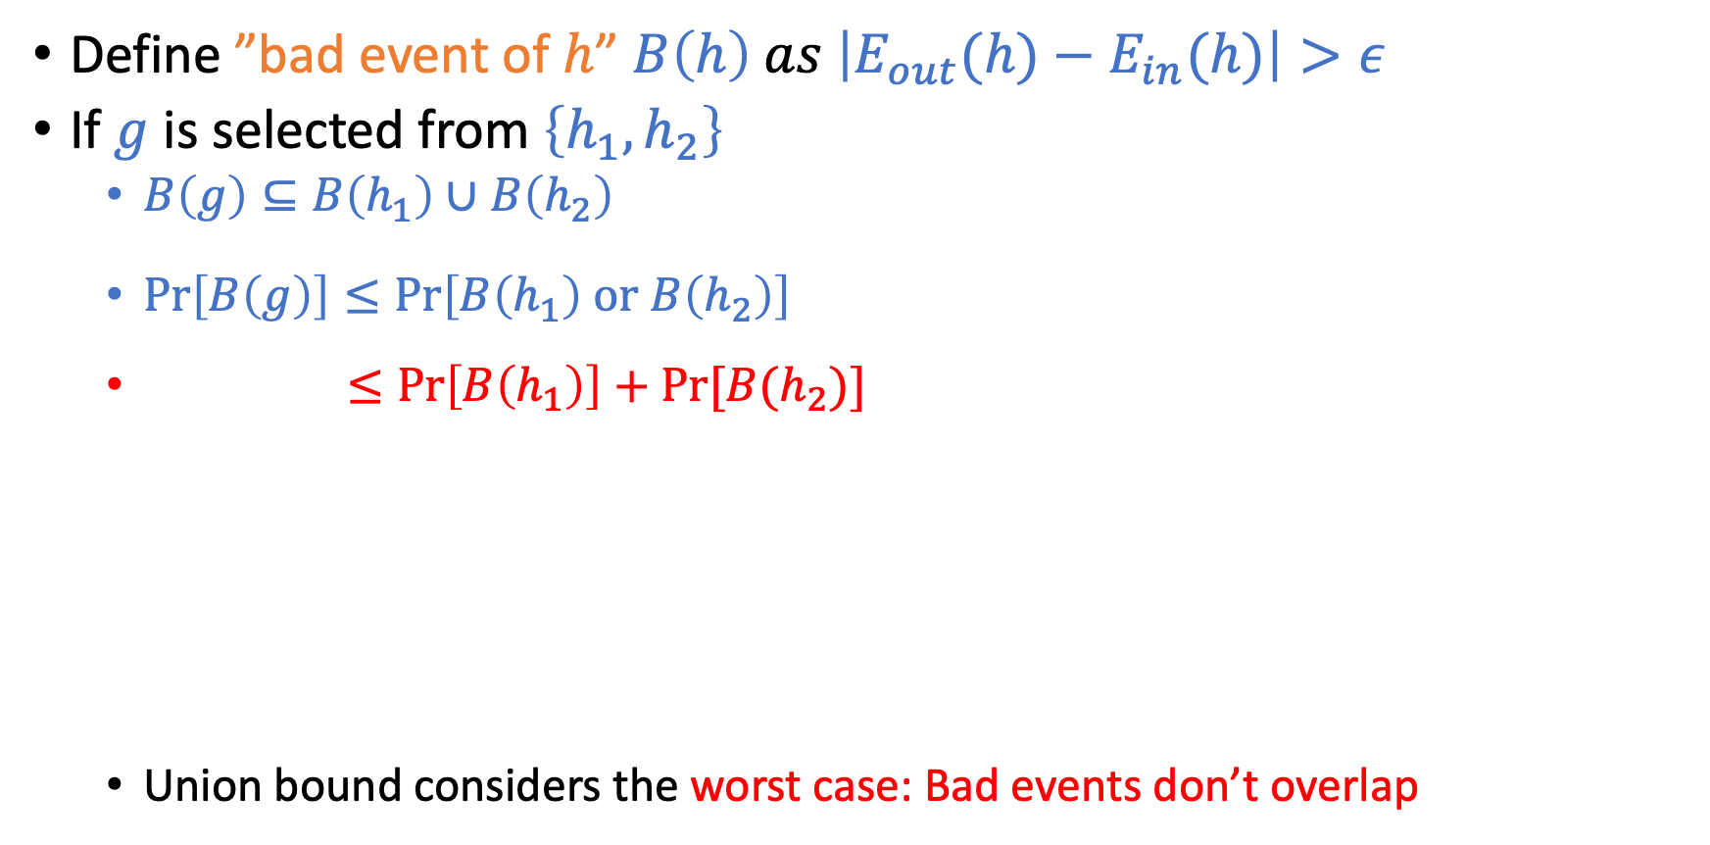
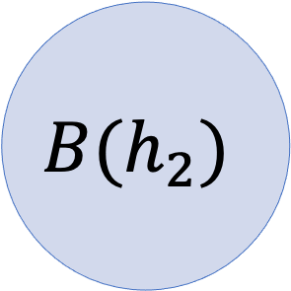
Key Intuitions in the Multi-Hypothesis Analysis
Define ”bad event of $h$” $B\left(h\right) as \left|E_{out}(h)−E_{in}(h)\right|>ε$
If $g$ is selected from $\left\{h_{1},h_{2}\right\}$
$B\left(g\right)⊆B\left(h_{1}\right)∪B\left(h_{2}\right)$
$\operatorname{Pr}\left[B\left(g\right)\right]≤\operatorname{Pr}\left[B\left(h_{1}\right) \text{or} B\left(h_{2}\right)\right]$
$≤\operatorname{Pr}\left[B\left(h_{1}\right)\right]+Pr⁡[B(h_{2})]$
Union bound considers the worst case: Bad events don’t overlap
(Union Bound)
$$B(h_{1})$$
$$B(h_{2})$$

Slide 42
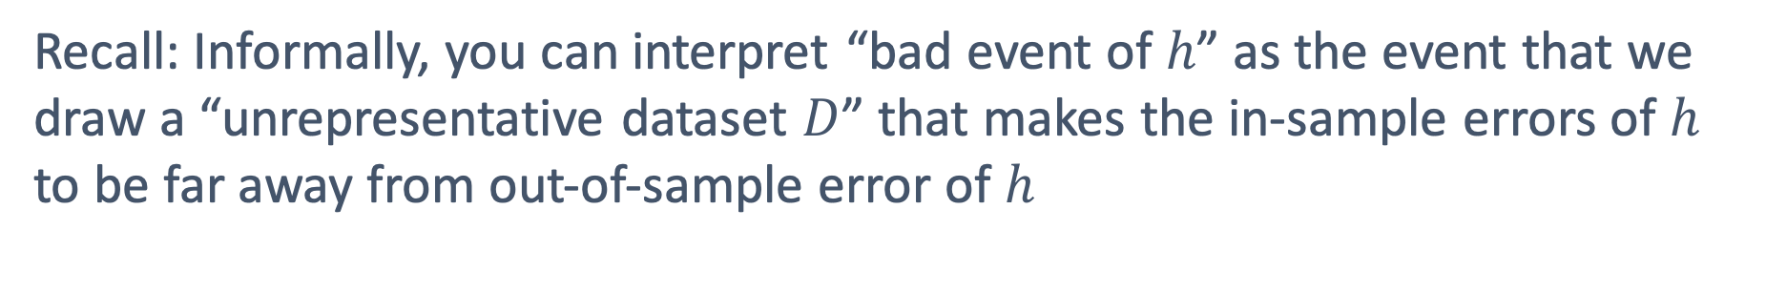
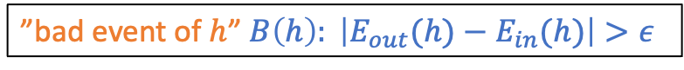
Do Bad Events Overlap?
Oftentimes, they overlap a lot!
The two linear separators on the left make
the same predictions for most points.
If it’s a bad event for one, it’s likely to be
a bad event for the other.
”bad event of $h$” $B\left(h\right): \left|E_{out}(h)−E_{in}(h)\right|>ε$
Recall: Informally, you can interpret “bad event of $h$” as the event that we
draw a “unrepresentative dataset $D$” that makes the in-sample errors of $h$ to be far away from out-of-sample error of $h$

Slide 43





What Can We Do?
Any difference between A and B?
For this dataset, probably not.
They make the same predictions for every data point in this dataset.

Slide 44
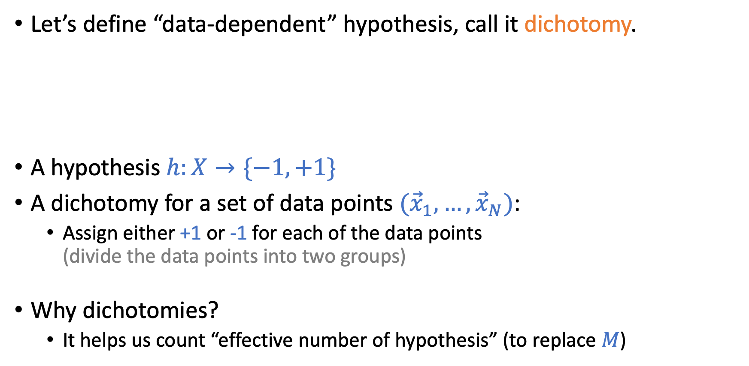
What Can We Do?
Let’s define “data-dependent” hypothesis, call it dichotomy.
A hypothesis $h:X→\{−1,+1\}$
A dichotomy for a set of data points $({\vec{x}}_{1},…,{\vec{x}}_{N})$:
Assign either +1 or -1 for each of the data points (divide the data points into two groups)
Why dichotomies?
It helps us count “effective number of hypothesis” (to replace $M$)

Slide 45
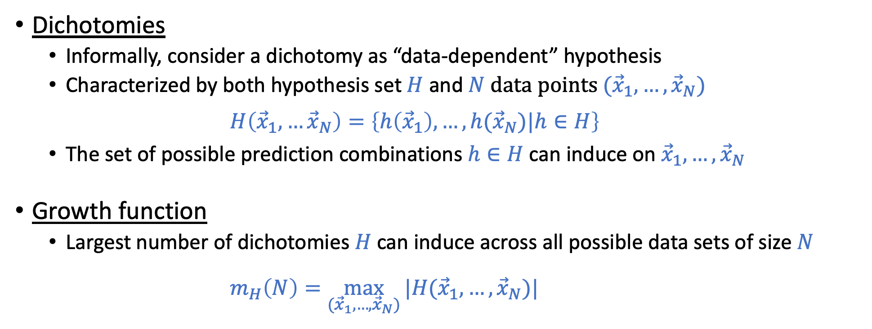
More Formal Definitions
Dichotomies
Informally, consider a dichotomy as “data-dependent” hypothesis
Characterized by both hypothesis set $H$ and $N$ data points $({\vec{x}}_{1},…,{\vec{x}}_{N})$ $H\left({\vec{x}}_{1},…{\vec{x}}_{N}\right)=\left\{h\left({\vec{x}}_{1}\right),…,h({\vec{x}}_{N})|h∈H\right\}$
The set of possible prediction combinations $h∈H$ can induce on${\vec{x}}_{1},…,{\vec{x}}_{N}$
Growth function
Largest number of dichotomies $H$can induce across all possible data sets of size $N$
$m_{H}\left(N\right)=\max_{({\vec{x}}_{1},…,{\vec{x}}_{N})}{|H({\vec{x}}_{1},…,{\vec{x}}_{N})|}$

